Slide 1
Spatial Analysis for Establishing a Vocational School for PWDs in Vietnam
Rachel Pham & Minh Tran

Slide 2
Table of Contents
Introduction
Vocational Education Needs for Individuals with Disabilities in Vietnam
Challenges and Study Rationale
Spatial Analysis
Part 1: Clusters Analysis
Part 2: Weighted Overlay
Part 3: Location Allocation
01
04
02
Study Area
Geographic and Demographic Overview
Selection Rationale
05
Results and Recommendation
Key findings from Spatial Analysis
Proposed Locations for the School
Feature Class
Data Types and Sources
Methodology
Conclusion
Summary and Final Thoughts
03
06

Slide 3
Introduction
Only 31.7% of PWDs* in the labor force vs. 82.4% non-disabled.
High educational gap: 93.4% of PWDs over 16 lack vocational skills.
COVID-19 impact: Significant job losses among PWDs.
Urgent need for improved vocational training for PWDs in Vietnam
*PWDs: People with disabilities

Slide 4
Our GIS Study Aims to
Identify accessible locations for new vocational schools, considering public transportation and essential services, and factors in population density and proximity to existing educational facilities.

Slide 5
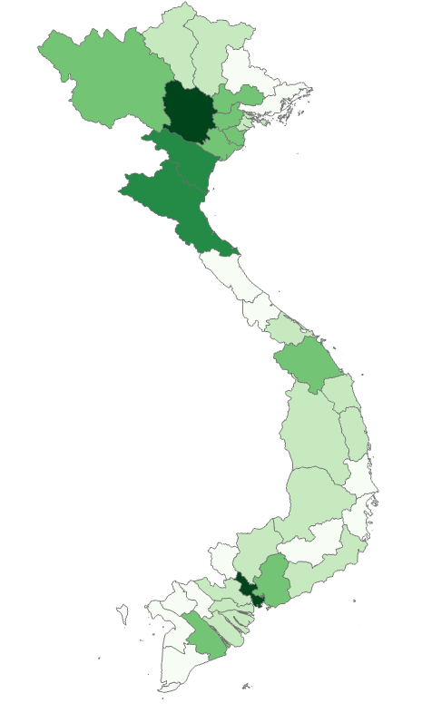
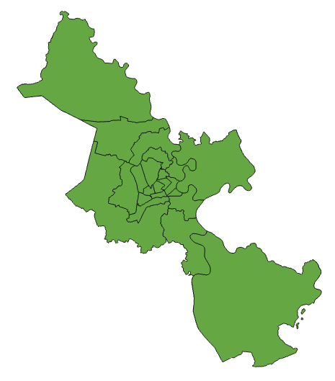
Study Area
Vietnam
City of Saigon

Slide 6
Feature Class
Public Transportation (Points)
---> ensure convenient travel
Hospital (Points)
---> access to medical facilities
Vocational Schools (Points)
---> avoid overlap
Spending Level (Raster)
---> ease financial strain
Land Use (Raster)
---> ensure accessibility
Disability Population (Polygon)
---> spot demand
Vietnam Boundary (Polygon)
---> define the study area

Slide 7
Spatial Analysis
Kernel Density
determining the study area based on population density to identify regions with high demand
Weighted Overlay
assigning weights and suitability scores to various data layers to formulate a suitability map
Location Allocation
select 05 provisional locations for potential schools and proceed with Location Allocation to ascertain the most optimal site among these choices
03

Slide 8
Spatial Analysis | Population Density Analysis
Hanoi
Heavily shaded regions indicates higher concentration of disabled population in urban areas. Suggest greater need for accessibility and vocational schools.
Saigon

Slide 9
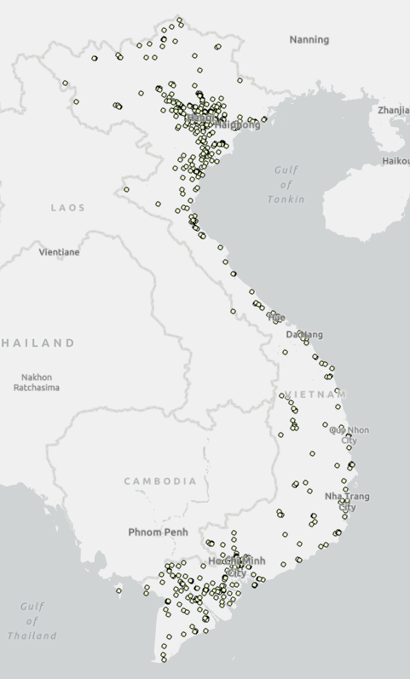
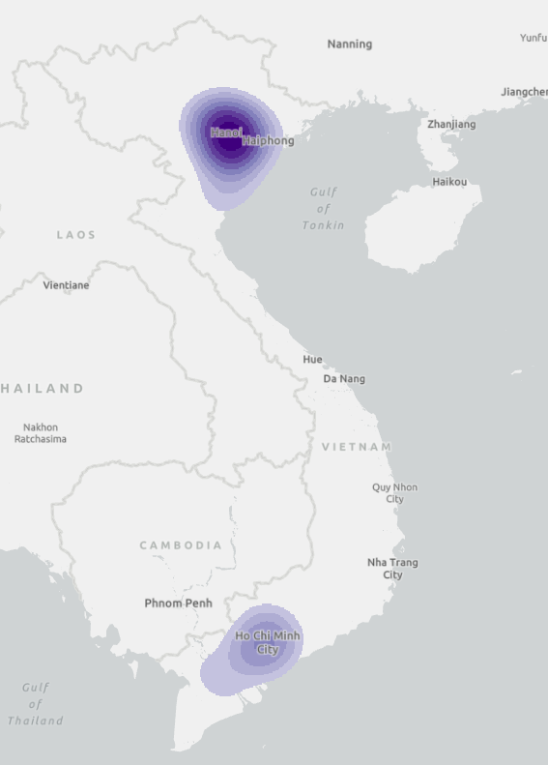
Spatial Analysis | Kernel Density Analysis
Conducted Kernel Density Analysis to locate concentrations of existing vocational schools.
Findings reveal a significant need in the South, indicating a service gap for vocational education.
This analysis guides our focus to address the underserved regions effectively.

Slide 10
Spatial Analysis | Weighted Overlay
Land Use
Hospital
Euclidean Distance
Reclassify
Current Vocational Schools
Euclidean Distance
Reclassify
Weighted Overlay
Suitability Map
Public Transports
Euclidean Distance
Reclassify
Spending Level

Slide 11
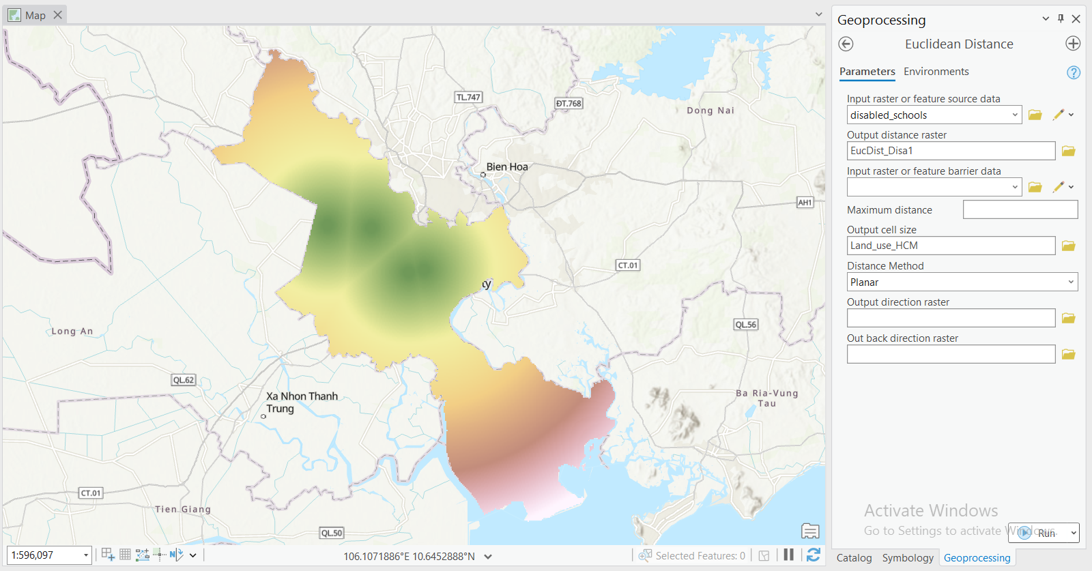
Spatial Analysis | Weighted Overlay
Step 1: Calculate Euclidean Distance for point features:
- Hospital
- Current Vocational Schools
- Public Transportation
Set the same Cell Size to all features

Slide 12
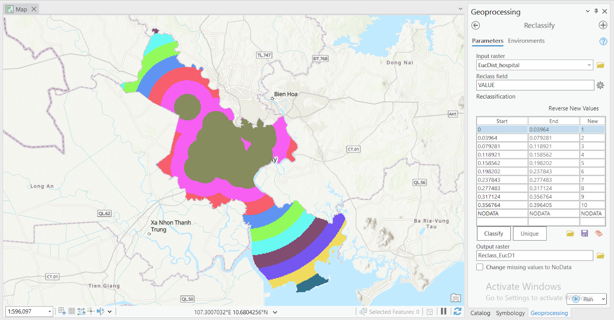
Spatial Analysis | Weighted Overlay
Step 2: Reclassify Distance Rasters
- Using Reclassify tool
- Reclassify into 10 classes

Slide 13
Spatial Analysis | Weighted Overlay
Name | Scale | Percent Influence
Land Use | - Urban/Built Up: 10 - Grass/Shrub: 6 - Rice, Woody Crops/Orchards: 3 - Other Crops: 4 - Barren: 2 - Water and Other Forests: Restricted | 45%
Hospital | Proximity weighted 10 to 1 | 10%
Current Vocational Schools | Proximity weighted 1 to 10 | 15%
Public Transport | Proximity weighted 10 to 1 | 20%
Spending Level | Lower cost areas rated higher from 10 to 1 | 10%
Step 3: Assign weights
In the Weighted Overlay tool, we set the scale to 10 and added all the criteria into the Weighted Overlay table then assigned weights to each feature.

Slide 14
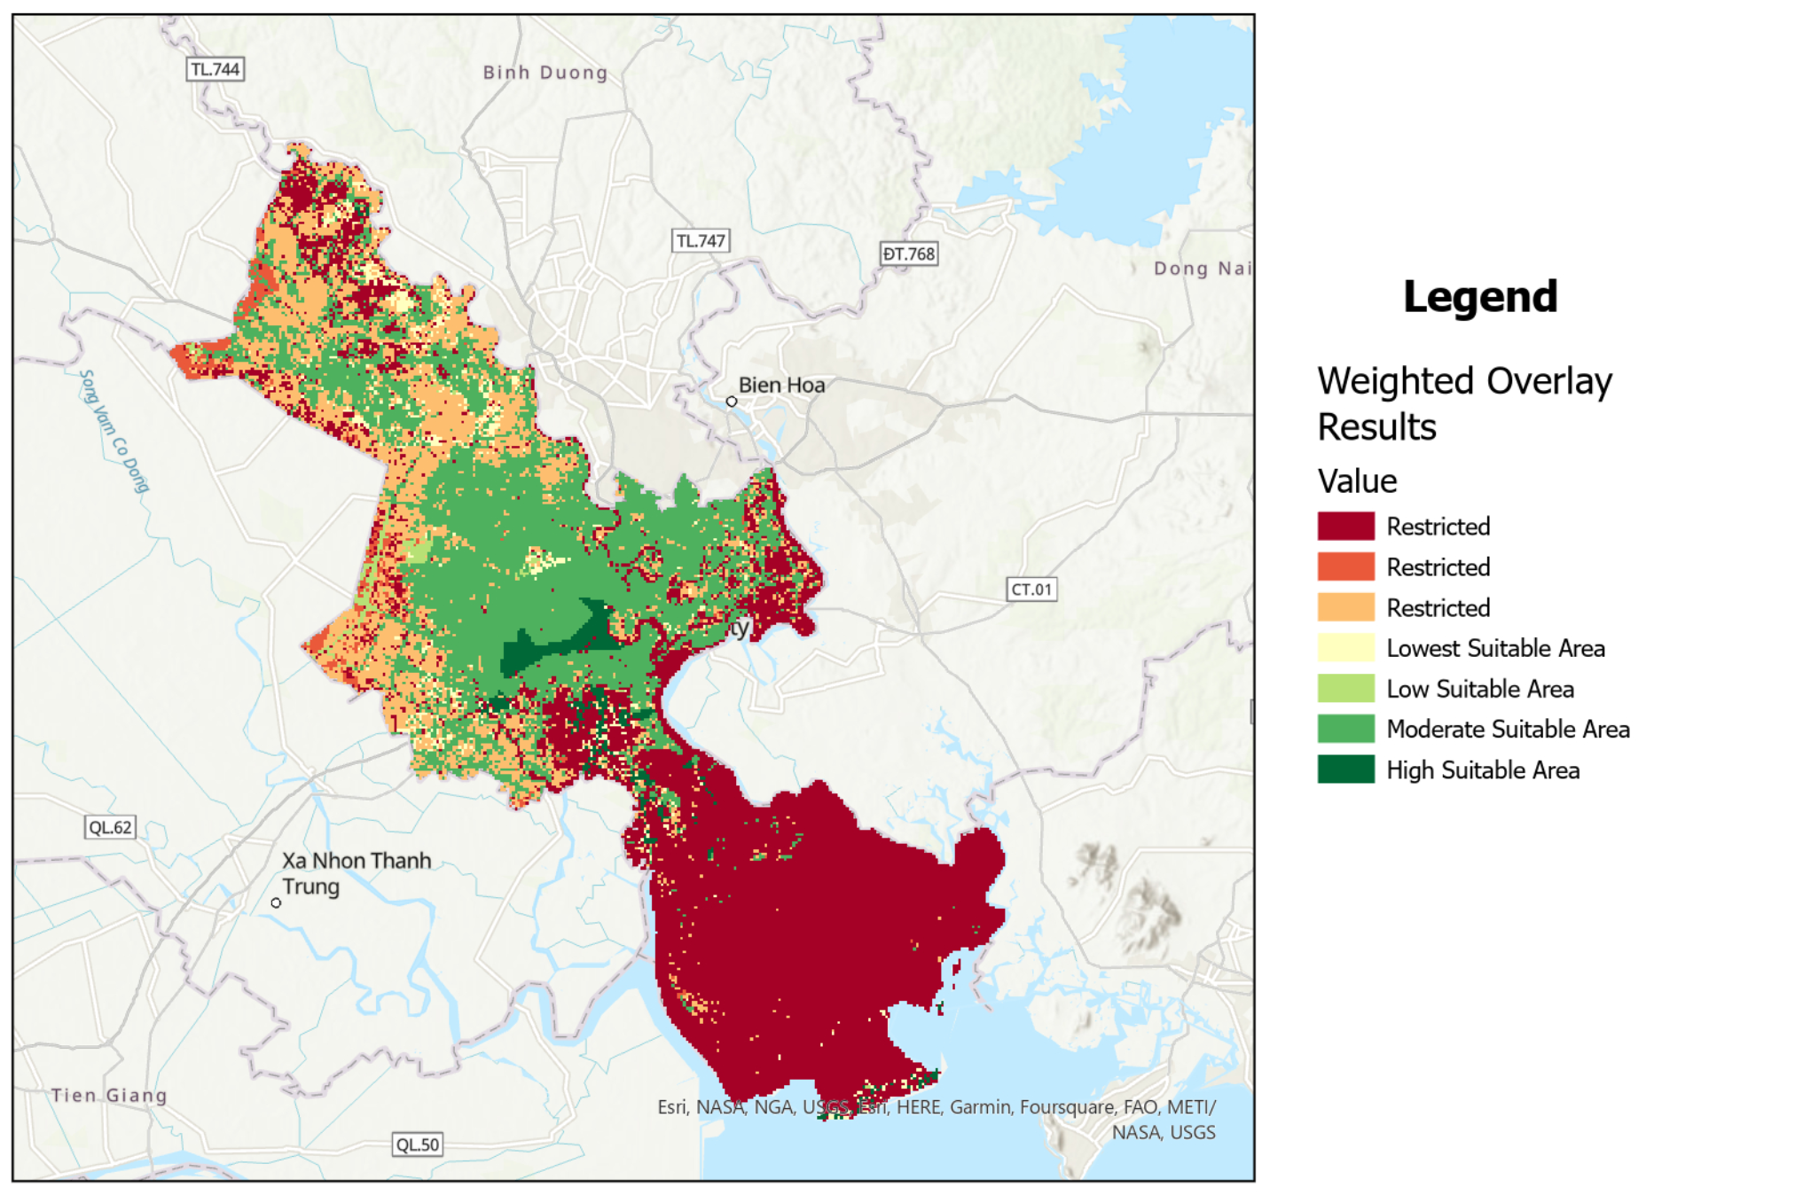
Spatial Analysis | Weighted Overlay
Suitability Map
Legends:

Slide 15
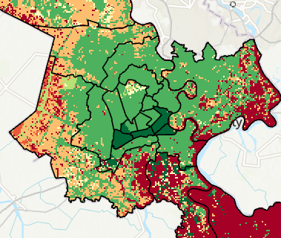
Spatial Analysis | Weighted Overlay
Darkest green areas indicating the most suitable locations

Slide 16
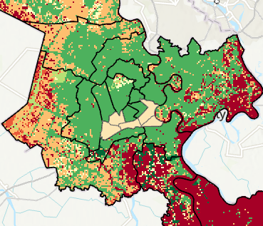
Spatial Analysis | Weighted Overlay
Selected Districts:
District 1, 4, 5, 6 and 11

Slide 17
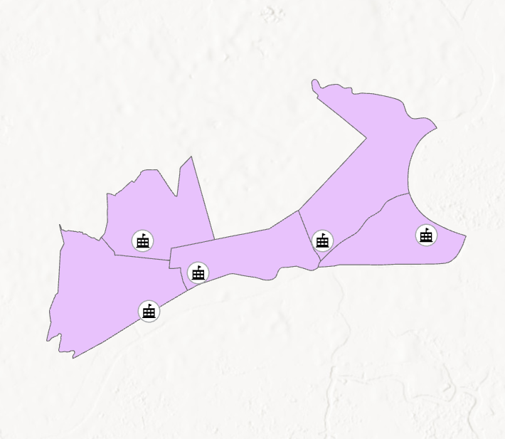
Spatial Analysis | Location Allocation
Within these districts, we generated 5 random locations, designating them as potential construction sites granted preliminary approval.

Slide 18

Spatial Analysis | Location Allocation
Potential Schools
Bus Stops
Competitor Schools
Facility Points
Demand Points
Location Allocation

Slide 19
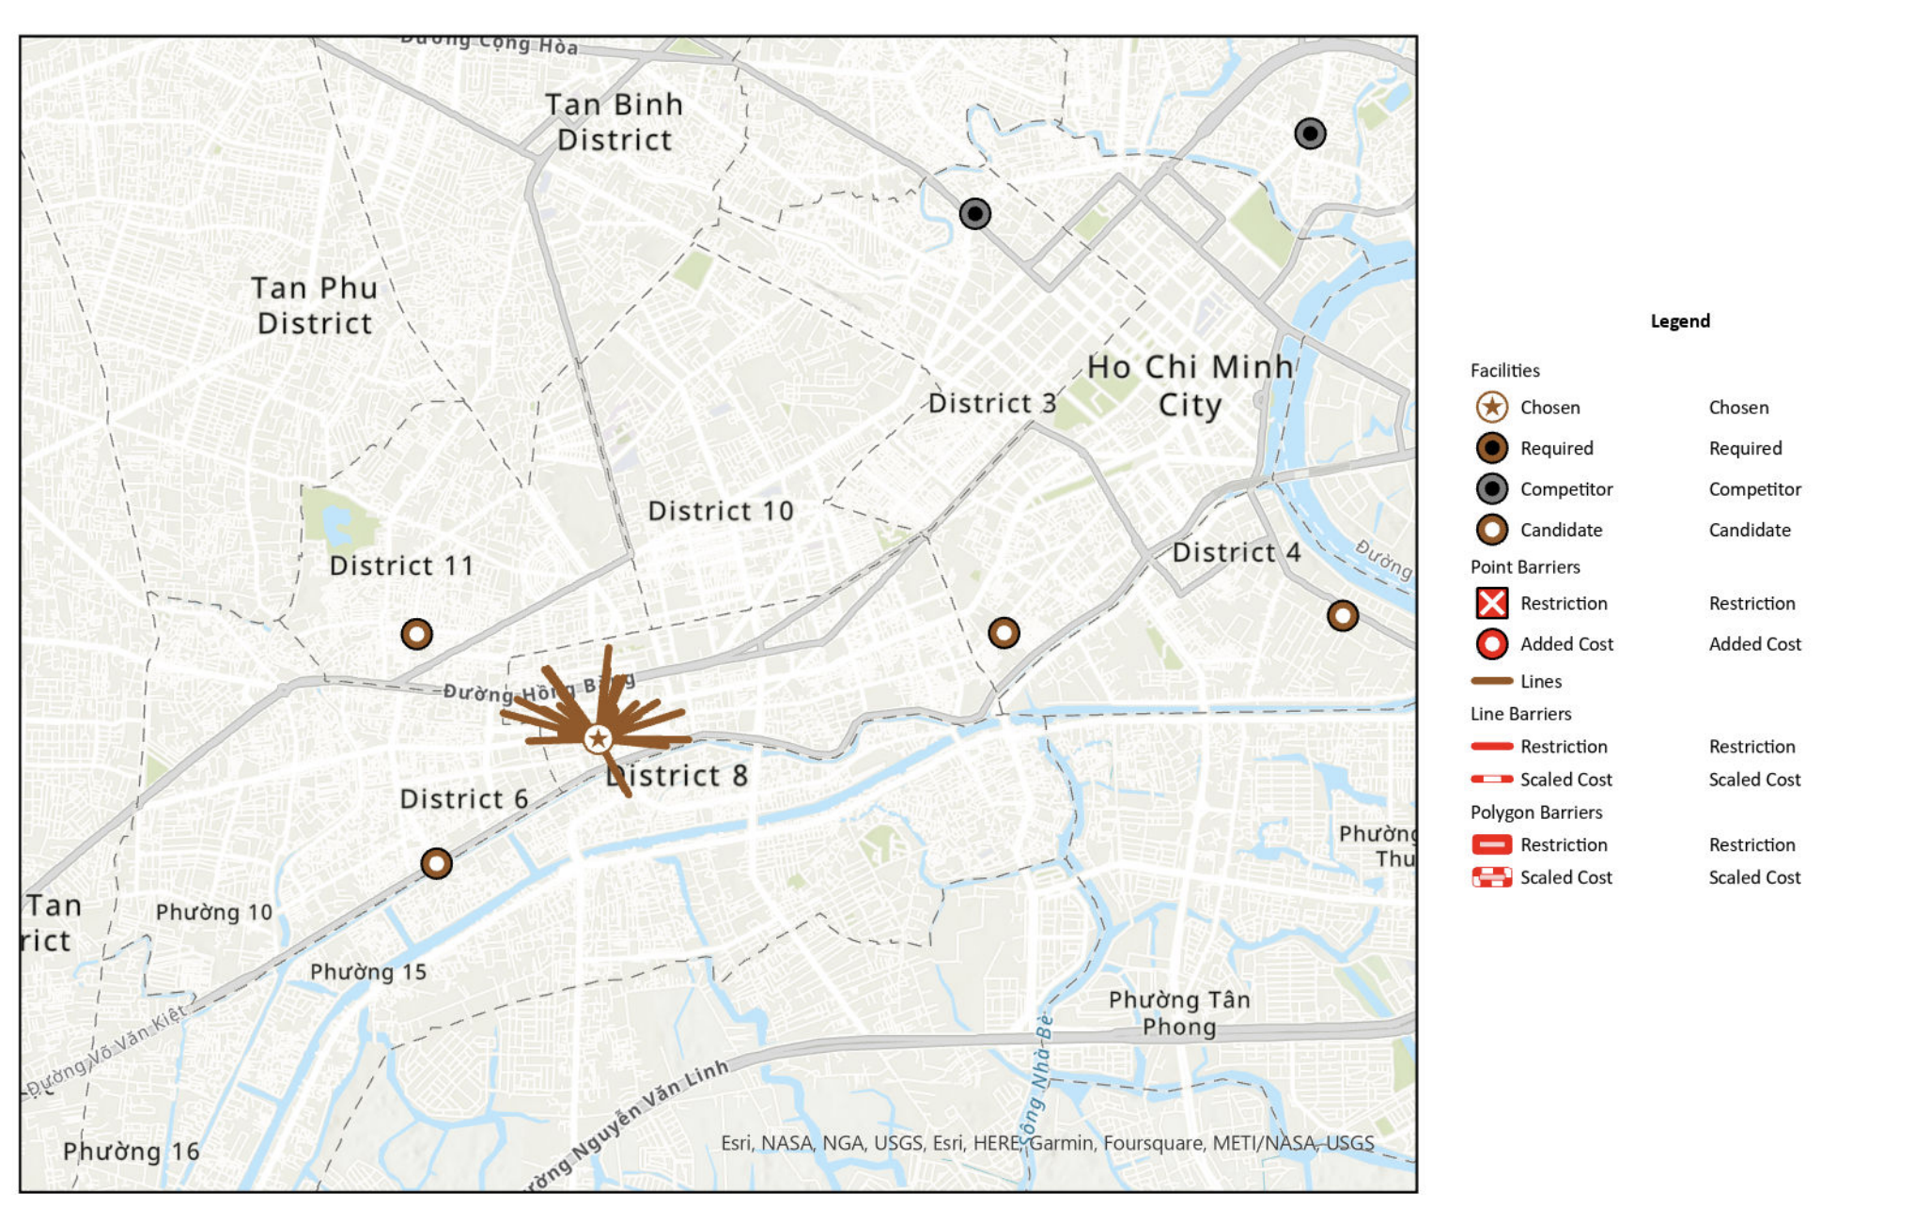
Spatial Analysis | Location Allocation
Suitability Map
Legends:

Slide 20
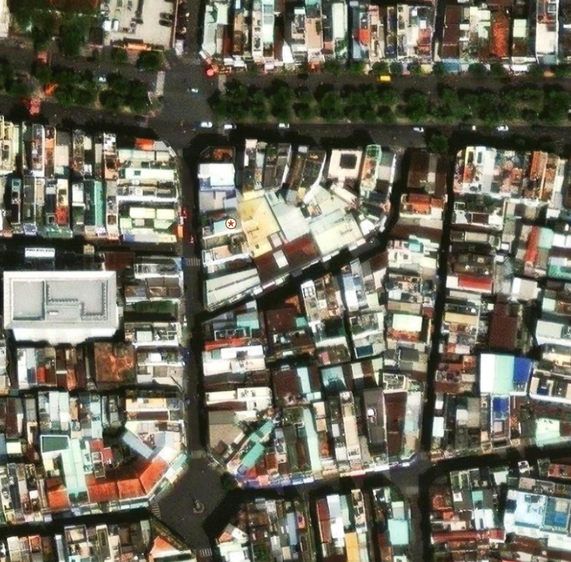
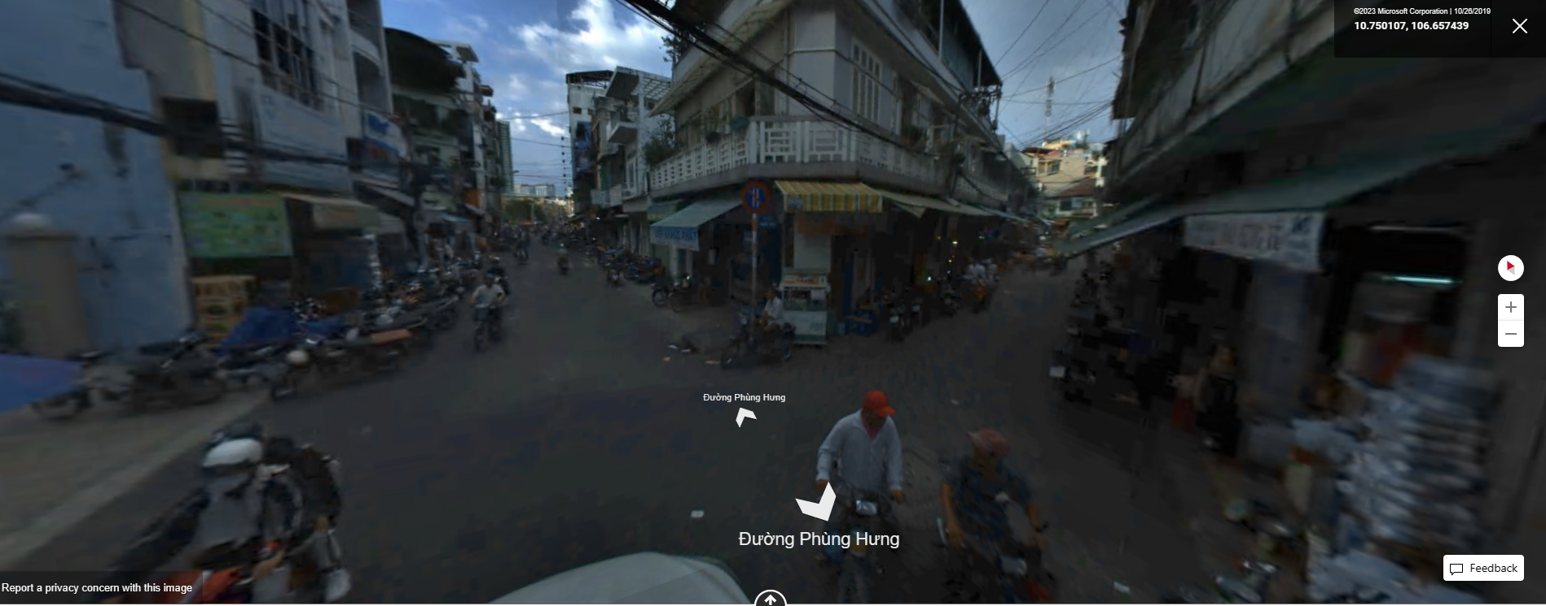
Results and Recommendation

Slide 21
Conclusion
Let’s get the ball rolling!

Slide 22
